Slide 1

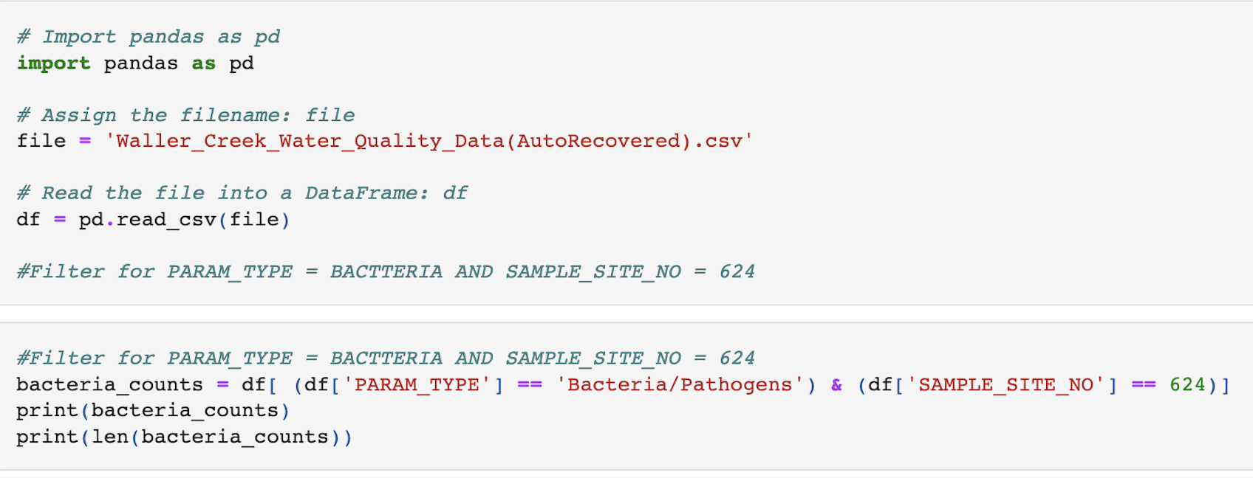
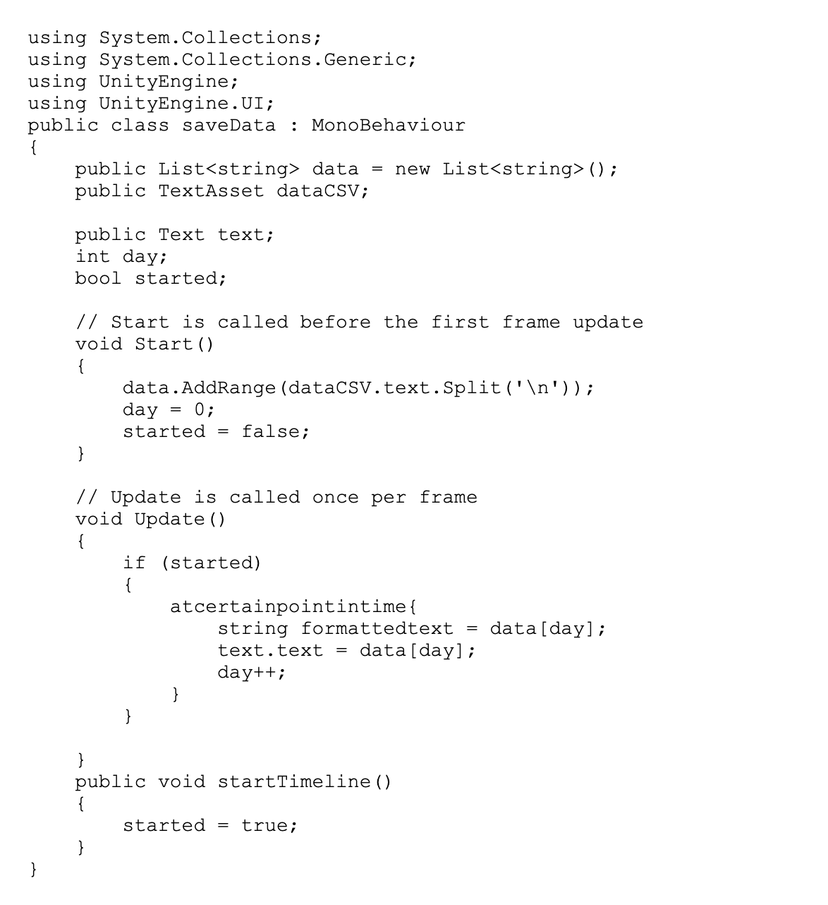
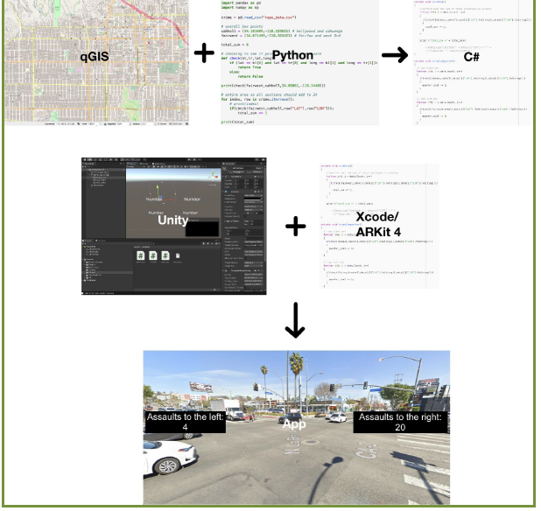
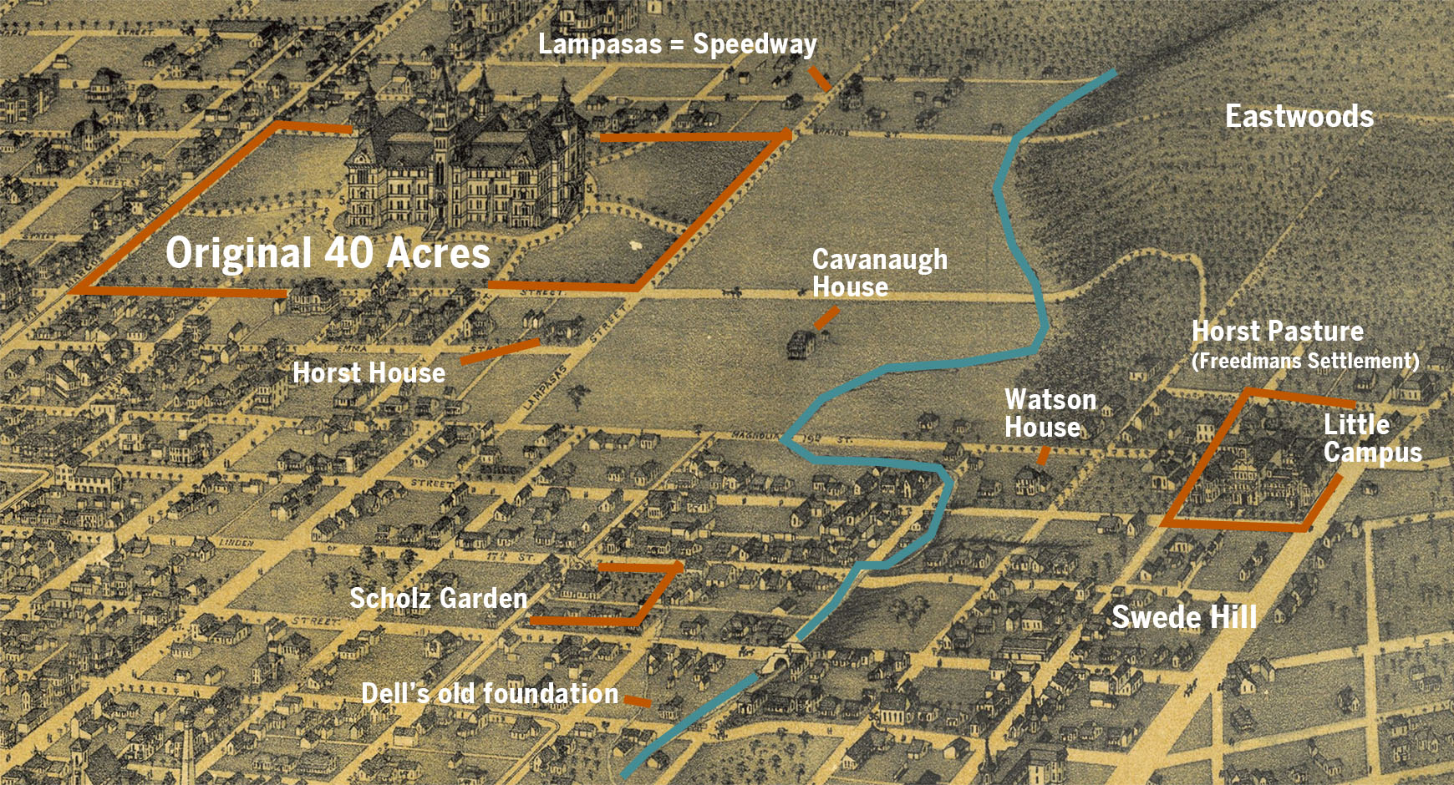

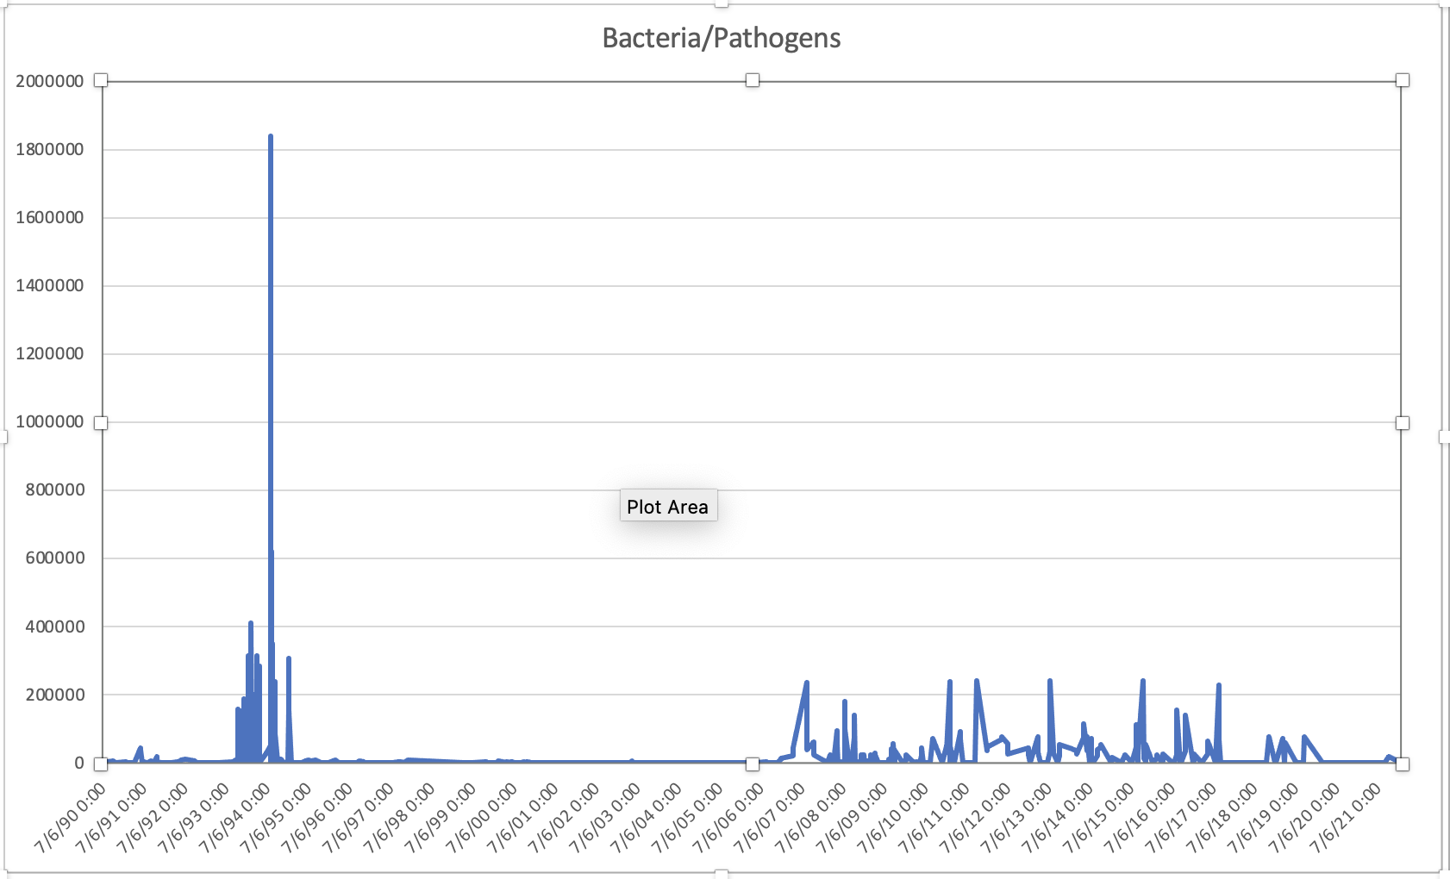

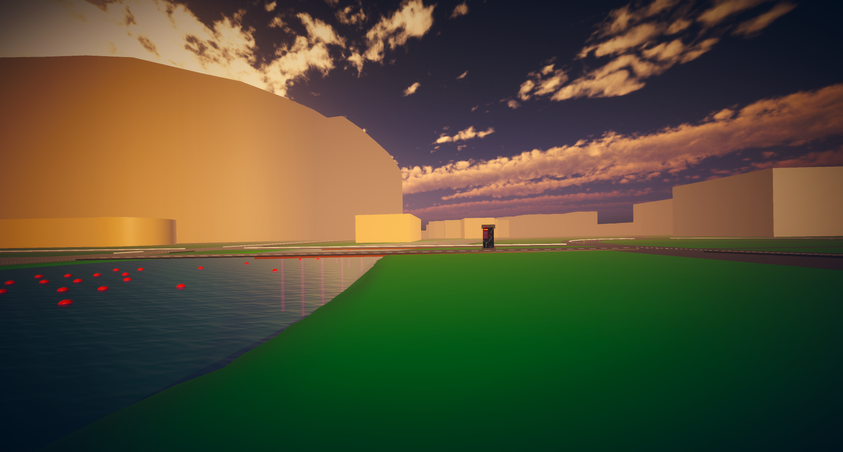
Time-Series Pollution Data in VR
Jordan Childs, TACC University of Texas at Austin, jordanchilds030@utexas.edu
Dr. Anne Bowen, TACC, adb@tacc.utexas.edu
Background
Research Questions
Results or Conclusion
The Waller Creek virtual reality project is an ongoing collaboration between researchers at TACC and the Waller Creek research group to create an immersive environment to explore geolocated water quality sensor data as well as biodiversity data from the iNaturalist database.
This project added the infrastructure (python, and C# scripts in Unity) to utilize time-series pollution data (bacterial) from City of Austin water stations and surveys.
Design an immersive interface for visualizing time-series water quality data at a water station.
Implement scripts and code to import data into Unity3D (python and C#).
Improve flexibility of code to work with more diverse sources of time series data (USGS water levels) .
Add interactive controls to allow users to manipulate the data (e.x. timeline control and viewing multiple sources of data).
Computational Workflow
Acknowledgments
Python
This work was made possible with support from the National Science Foundation Award #2150390.
I would like to thank the Texas Advanced Computing Center (TACC) Ravi Akalkotkar, Dr. Anne Bowen and other staff helping me throughout this process.
C#
Bacteria
Prototype:
The added scene will change the color of the water according to the concentration of bacteria over time.
There will be interactive orbs visible to users that display statistics on water pollution.
References
City of Austin Watershed Protection Environmental Resource Management. (2022, July 15). Water quality sampling data: Open data: City of austin Texas. data.austintexas.gov. Retrieved July 26, 2022, from https://data.austintexas.gov/Environment/Water-Quality-Sampling-Data/5tye-7ray

